Slide 1

Submitted to: Mr. AMAN Mr. JASVINDER SINGH Mr. ROBIN TYAGI
CS18.391
IBM Project
Topic:Traffic Density Management System
Submitted by:
Aparajita Halder(170396)
Neha Sharma(170409)
Yukta Dadhich(170418)
Mahima Fulwaria(170422)

Slide 2
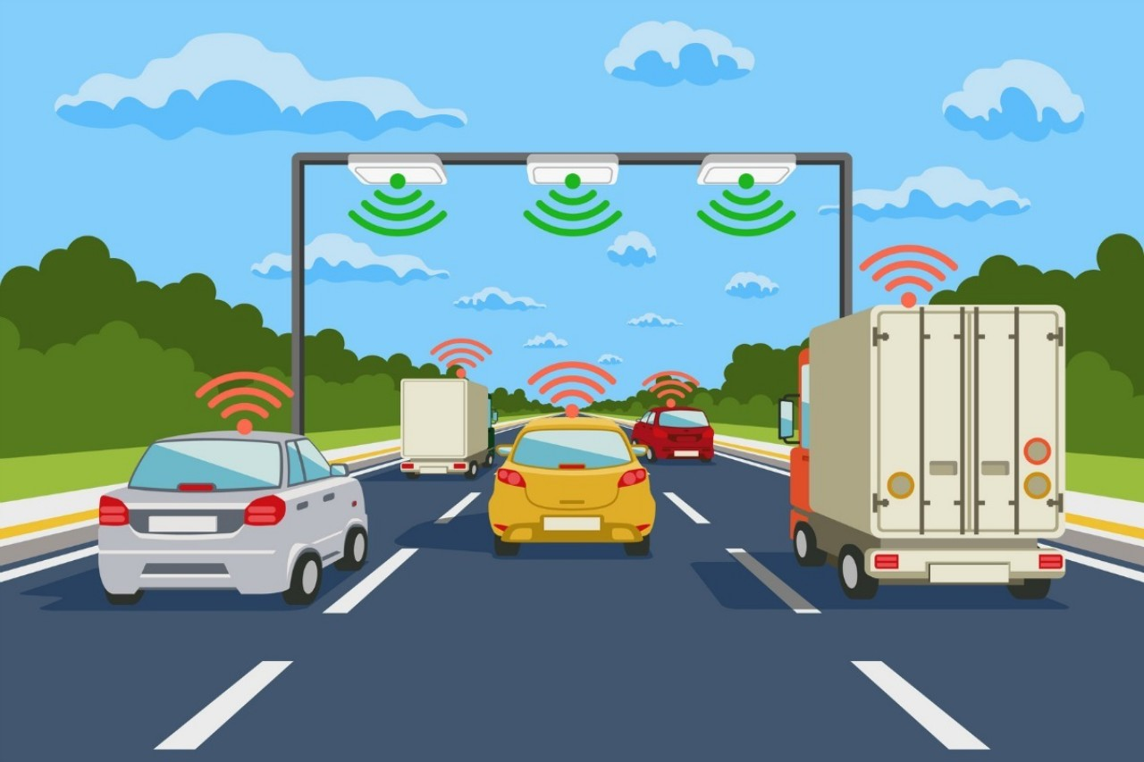
INTRODUCTION
The project is designed to develop a density based dynamic traffic signal system. The signal timing changes automatically on sensing the traffic density at the junction. Traffic congestion is a severe problem in many major cities across the world and it has become a nightmare for the commuters in these cities. Conventional traffic light system is based on fixed time concept allotted to each side of the junction which cannot be varied as per varying traffic density .

Slide 3
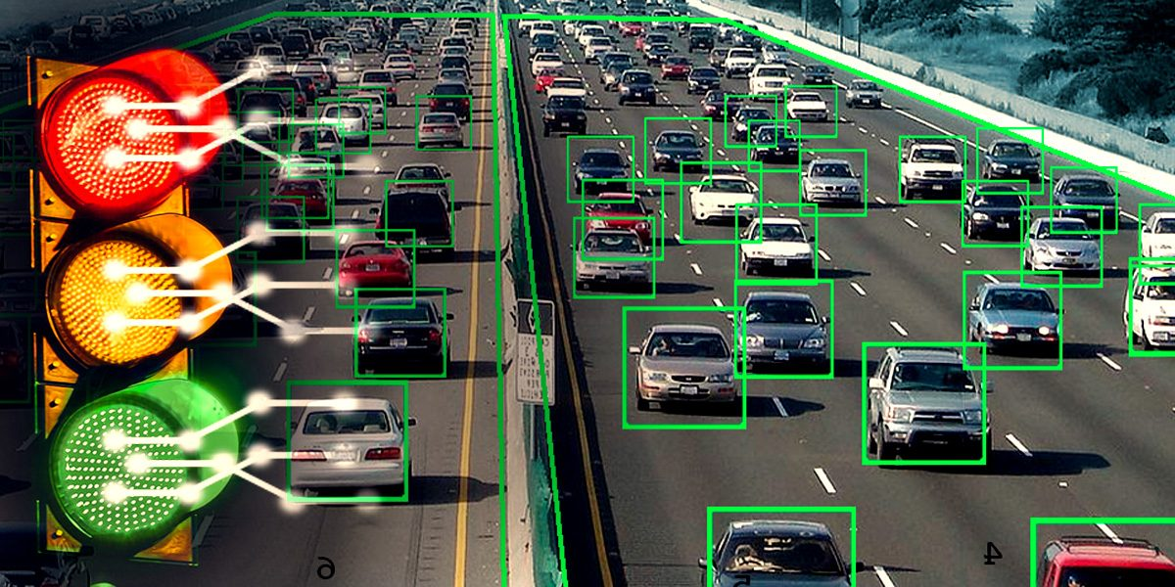
Working
The camera will capture the image of each road and count the number of vehicles present in each road. It will find the road with maximum density and show green signal to that road and “stop” signal to others. This system will then follow for other remaining roads until all roads are covered.

Slide 4
Junction timings allotted are fixed. Sometimes higher traffic density at one side of the junction demands longer green time as compared to standard allotted time. The image captured in the traffic signal is processed and converted into grayscale image then its threshold is calculated based on which the contour has been drawn in order to calculate the number of vehicles present in the image. After calculating the number of vehicles we will come to know in which side the density is high based on which signals will be allotted for a particular side.

Slide 5
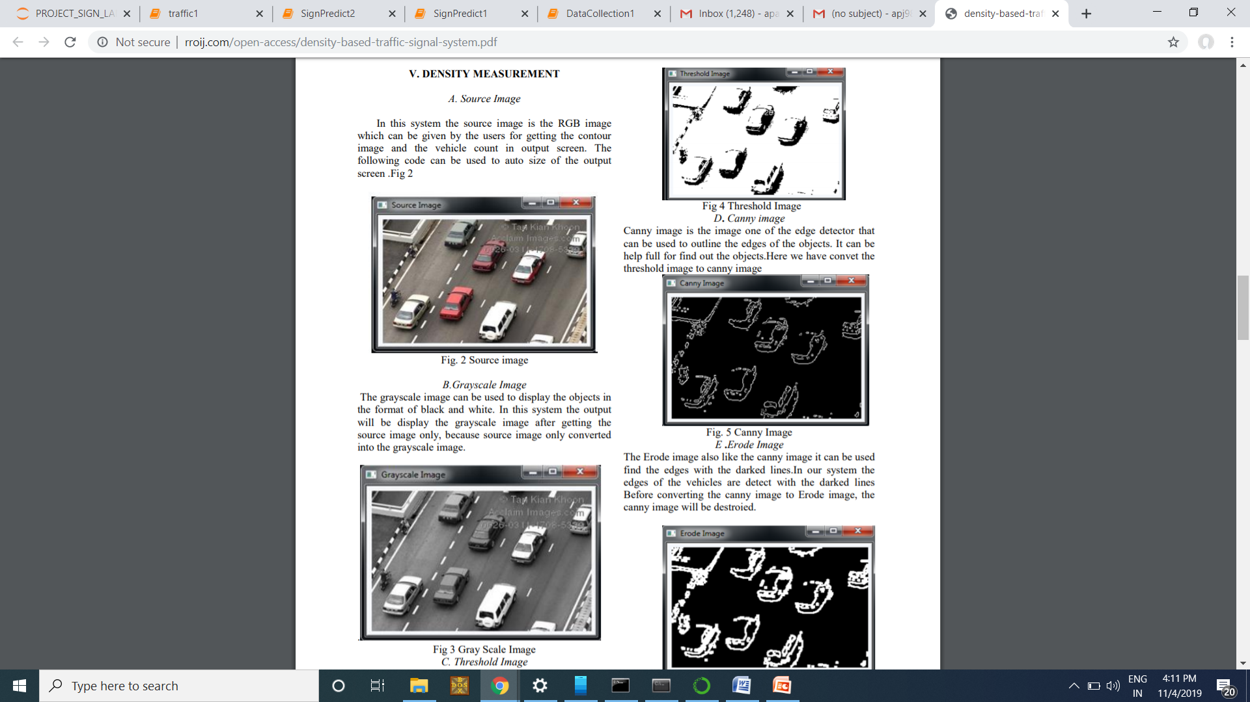
Source Image In this system, the source image is the RGB image which can be given by the users for getting the contour image and the vehicle count in output screen.
Image Conversion

Slide 6
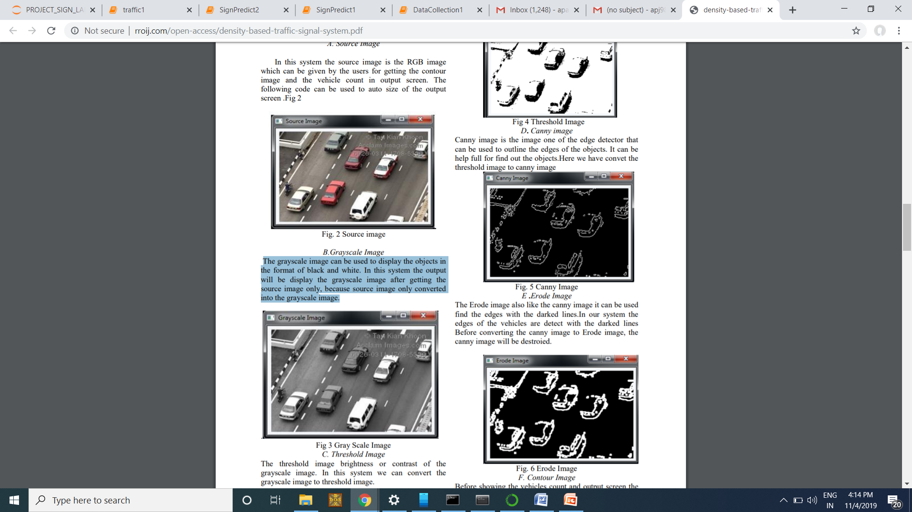
Grayscale Image The grayscale image can be used to display the objects in the format of black and white. In this system the output will display the grayscale image after getting the source image only, because source image is converted into the grayscale image.

Slide 7
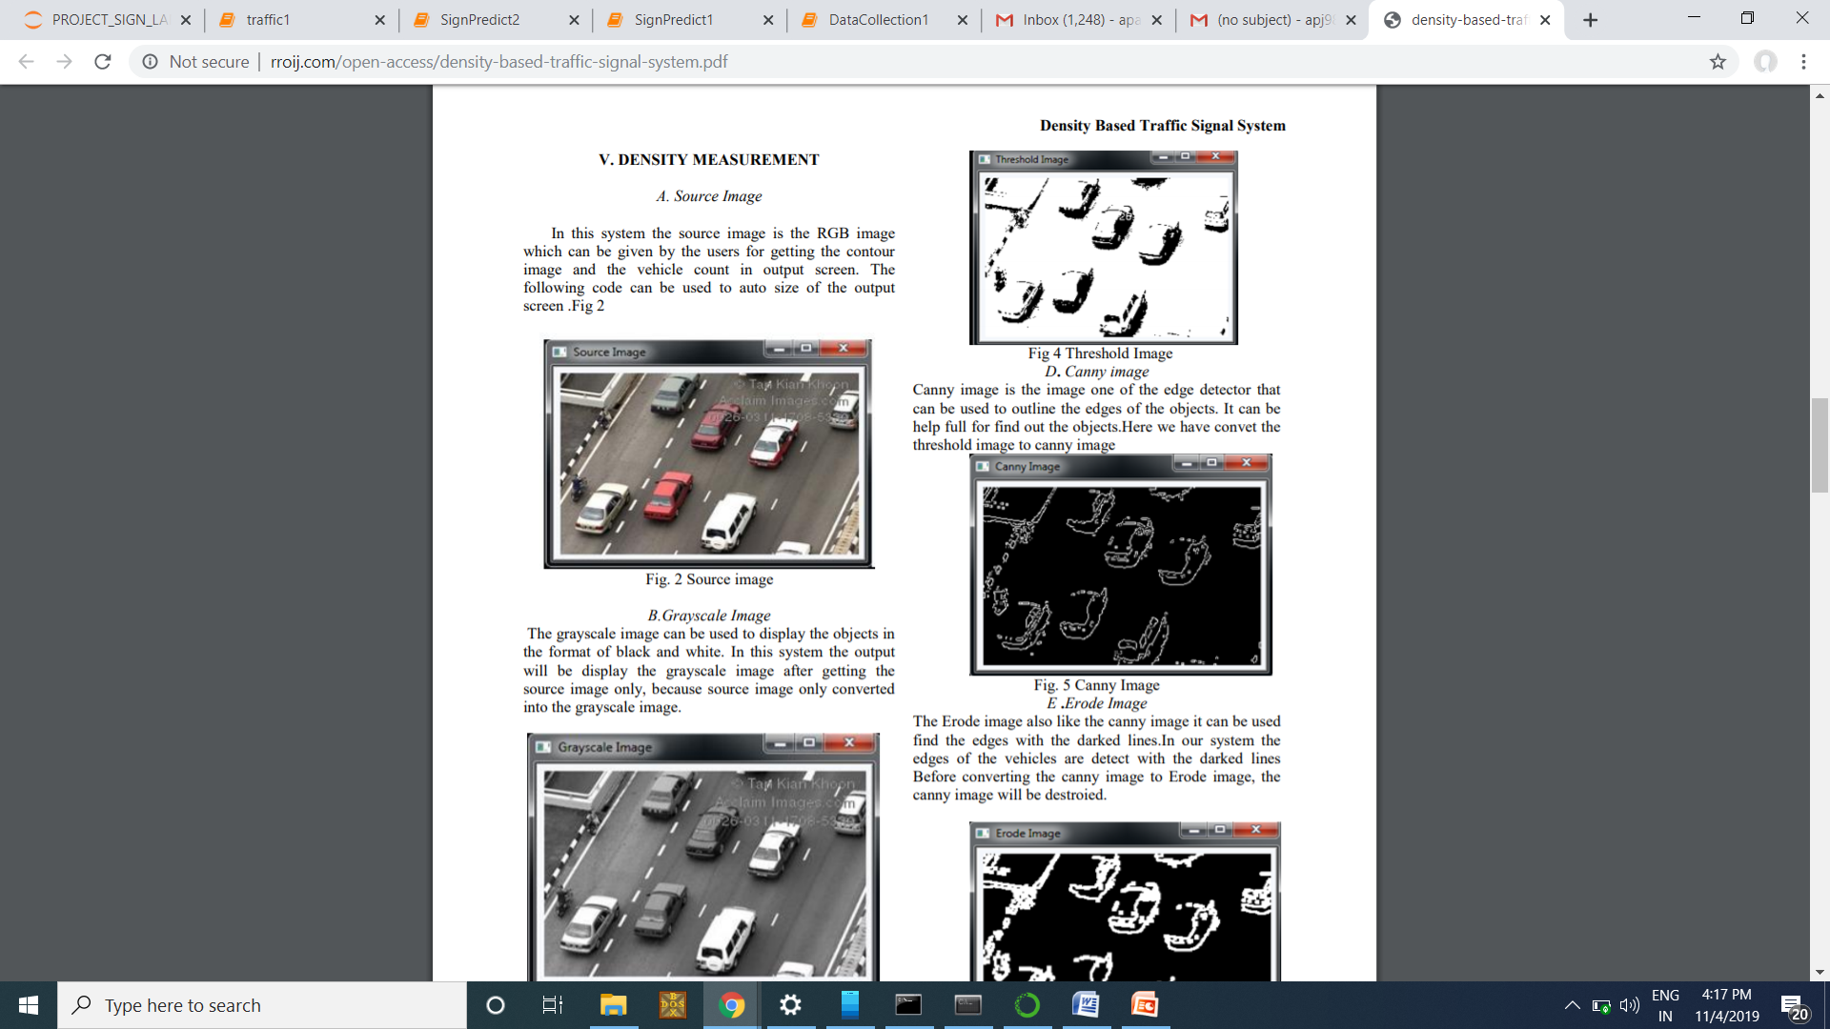
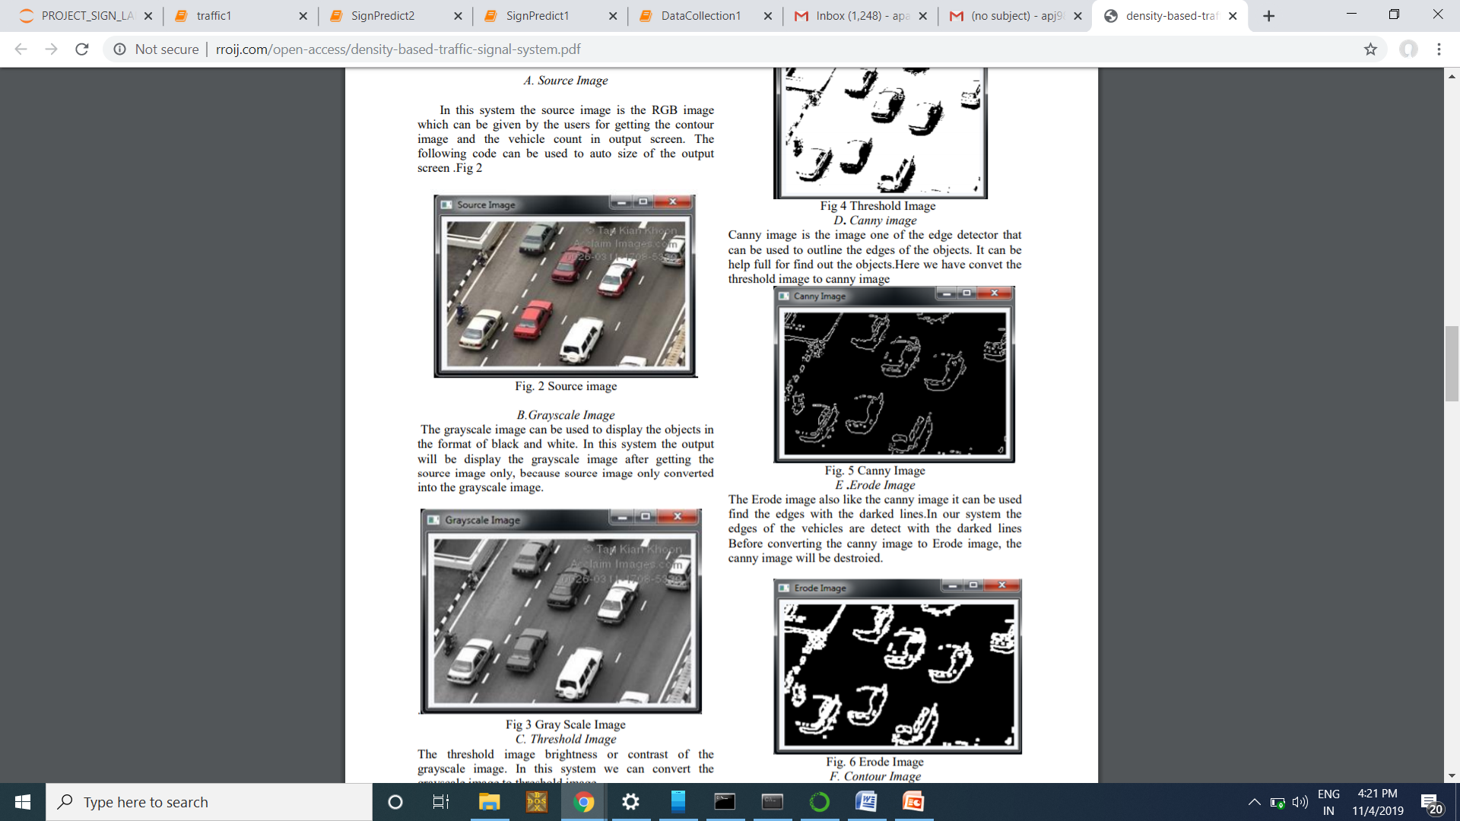
Threshold Image The threshold image increases brightness or contrast of the grayscale image. In this system we can convert the grayscale image to threshold image.
D. Canny image
Canny image is the image in which one of the edge detector can be used to outline the edges of the objects. It can be helpful for finding out the objects.

Slide 8
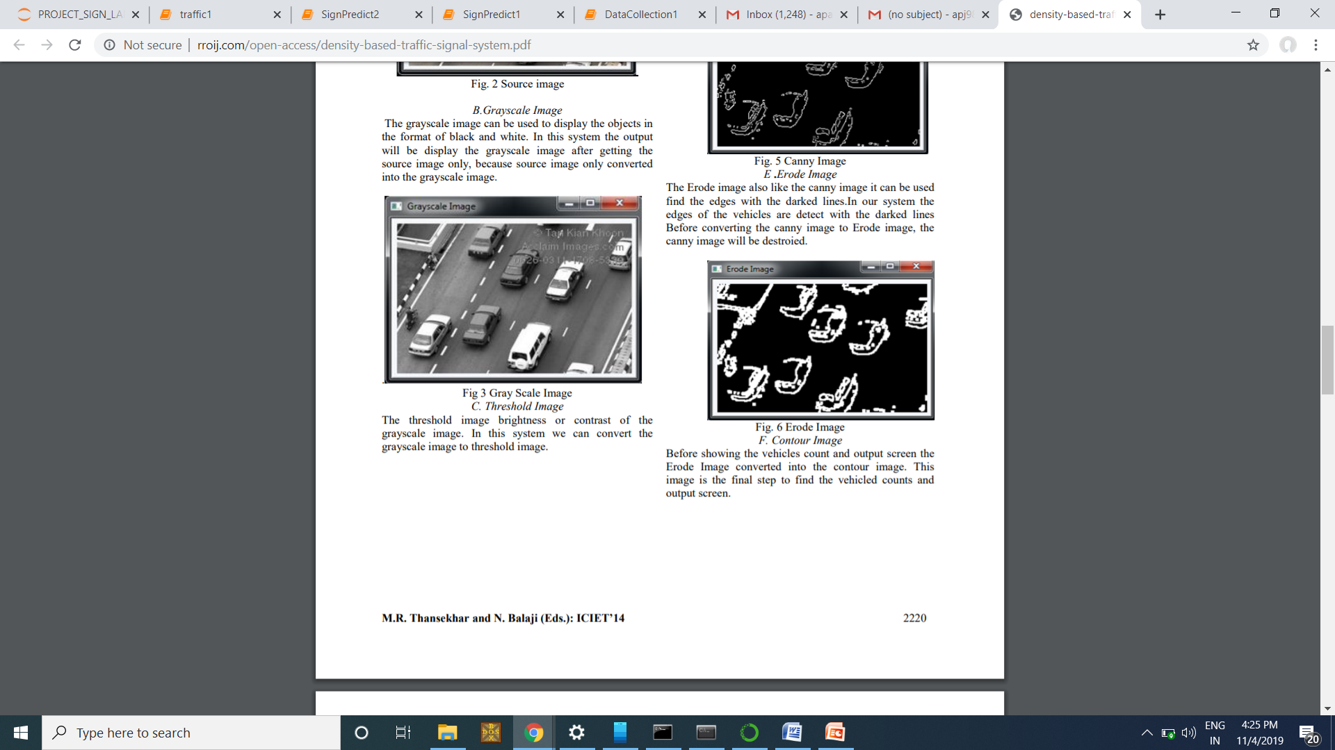
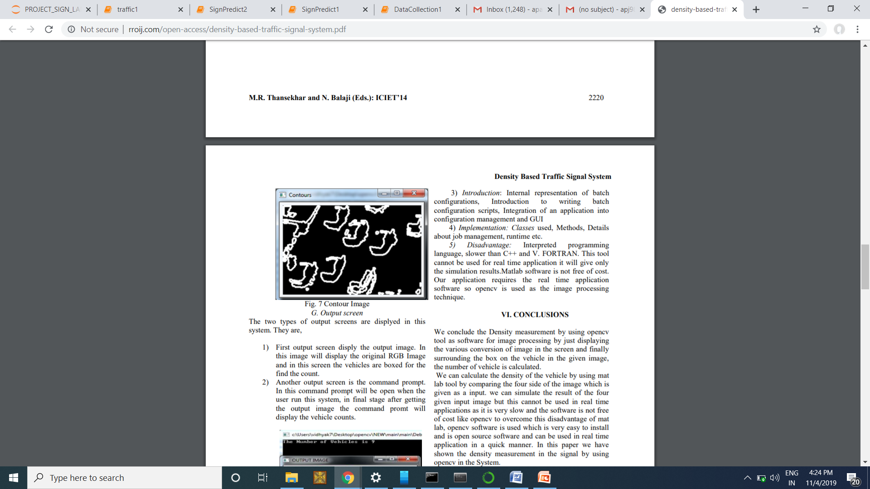
Contour image Before showing the cars count and output screen the erode image is converted into the contour image. This image is the final step to find the car counts and output screen.
Erode Image
The Erode image is like the canny image. It can be used to find the edges with the darked lines.In our system the edges of the vehicles are detected with the darked lines. Before converting the canny image to Erode image, the canny image will be destroyed.

Slide 9
TECHNOLOGIES TO BE USED

Slide 10
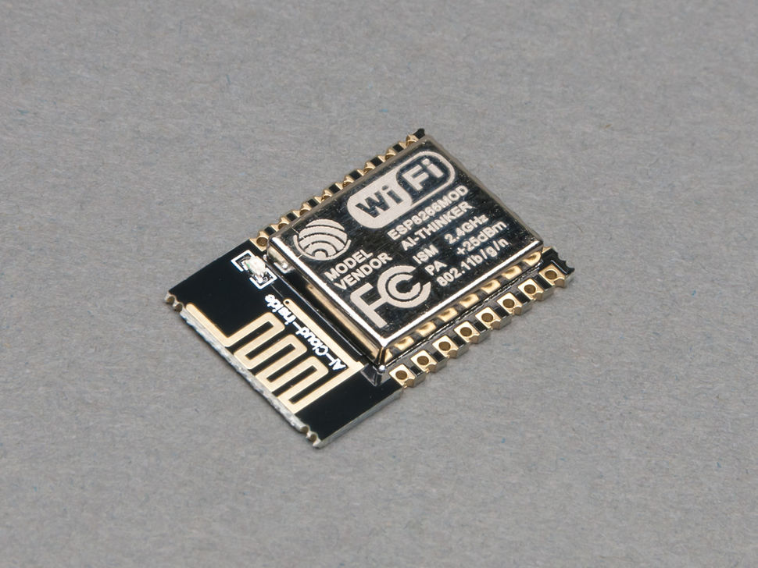
ESP8266 WiFi Module
The ESP8266 WiFi Module is a self contained SOC with integrated TCP/IP protocol stack that can give any microcontroller access to your WiFi network. The ESP8266 is capable of either hosting an application or offloading all WiFi networking functions from another application processor. We will send the image collected and required data to the assigned authorities over cloud through this device.

Slide 11

OpenCV
OpenCV (Open Source Computer Vision) is a library of programming functions mainly aimed at real-time computer vision. In simple language it is library used for Image Processing. It is mainly used to do all the operation related to Images.

Slide 12
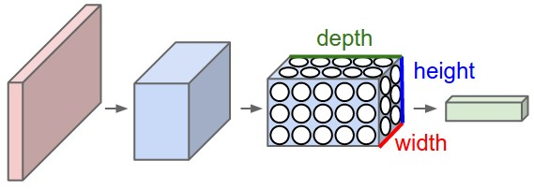
CNN
CNNs are powerful Artificial intelligence (AI) that use deep learning to perform image recognition and processing that is specifically designed to process pixel data. The CNN will be used to train vehicles in the system so that the system can differentiate the vehicles present in the captured frames.

Slide 13
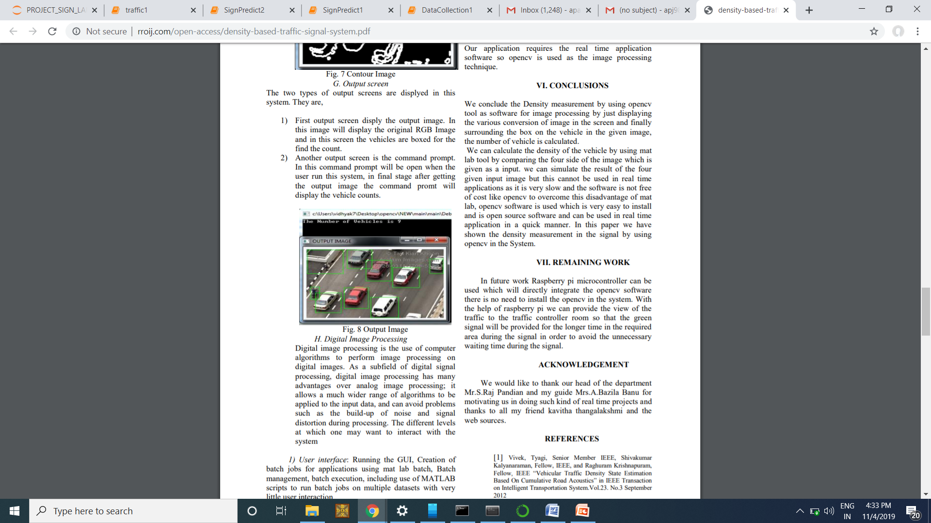
Present Implementation
We are developing the system in python programming language. Currently we have counted the cars present in frames using opencv and finding the frame with maximum density. Output screen display the output image. In this image will display the original RGB image and in this screen the vehicles are boxed for the find the count.

Slide 14
Future Implementation
In future the captured images will be sent to the authorities via IoT. We will use ESP8266 wi-fi module to do so . We will generate our own trained car dataset and train them through CNN. The trained model will predict cars and recognize them in live image . The captured images will then predict maximum density through the trained model.

Slide 15
THANK YOU!

